Slide 1
Expanding resources and opportunities for computational scientists to teach programming to middle- and high-school students
Computational STEM Lab:

Slide 2
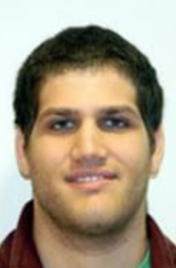
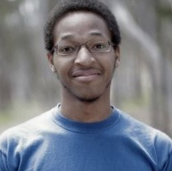
Jennifer Blanc
Graduate Student in Human Genetics
Eric Friedlander
Post-Doc in Ecology and Evolution
Workshop Presenters
Xinyi Li
Graduate Student in Human Genetics
Roy Morgan
Graduate Student in Genetics

Slide 3
What’s your name?
What grade are you in?
Do you have a hidden talent?
What are some of the ways you use computers?
Tell us about yourself!
Notes:
Use the icebreaker to get an idea of who is on what device for creating breakout rooms without calling them out

Slide 4

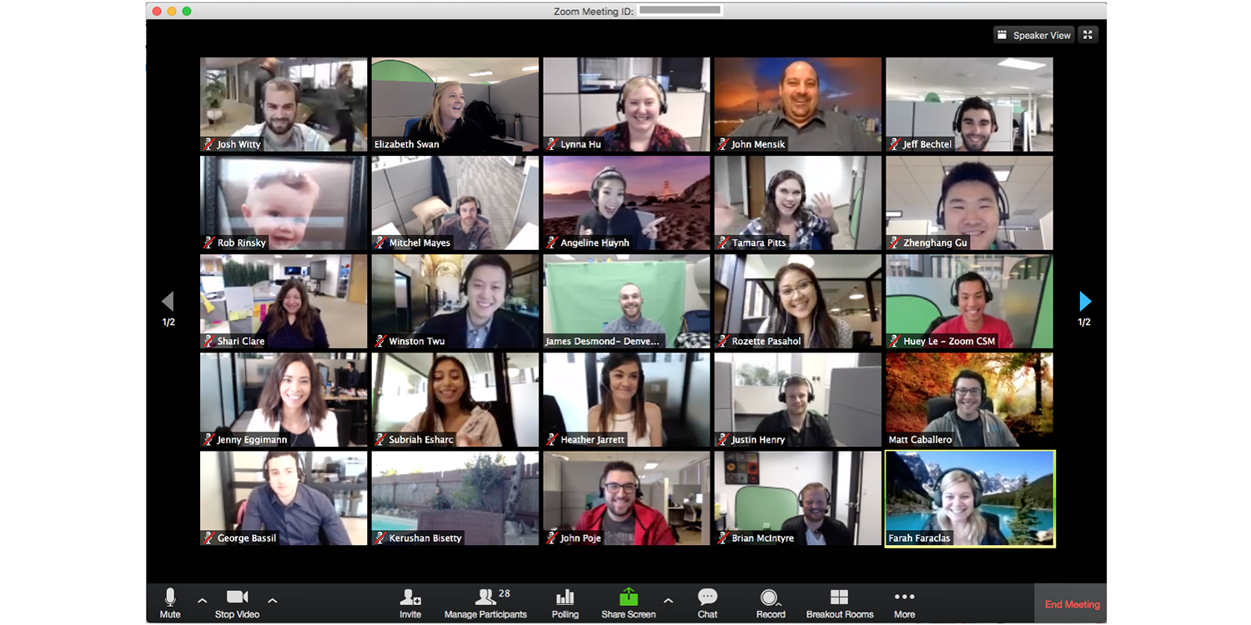
Computers are a part of our daily lives

Slide 5
In this workshop, we will...
Talk about how computers can be used in STEM fields and research
Learn coding basics (arithmetic, variables, functions) in the programming language Python using Jupyter Notebooks
Use what you’ve learned to figure out how a video goes viral!

Slide 6
Computers can be used for a range of tasks
From a calculator to a supercomputer, etc.

Slide 7
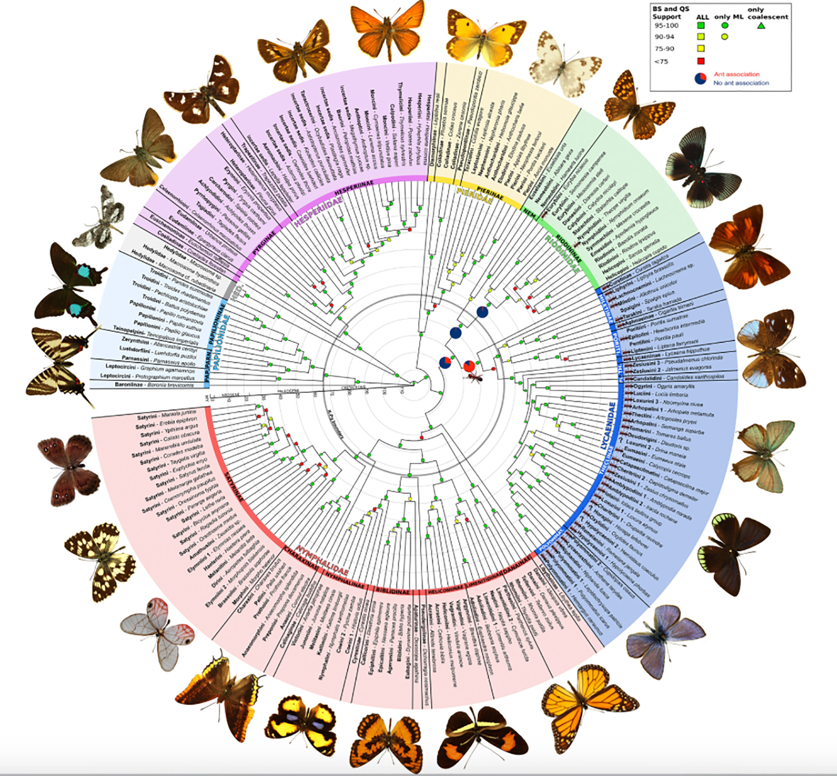
Computers can be used to make graphics...

Slide 8
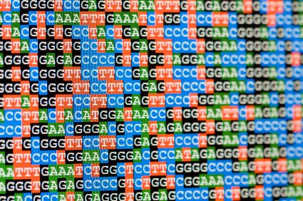
...process large amounts of data...

Slide 9
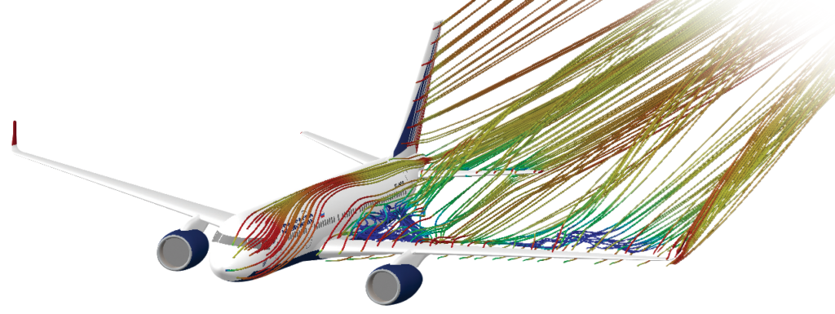
...or run simulations!

